Slide 1

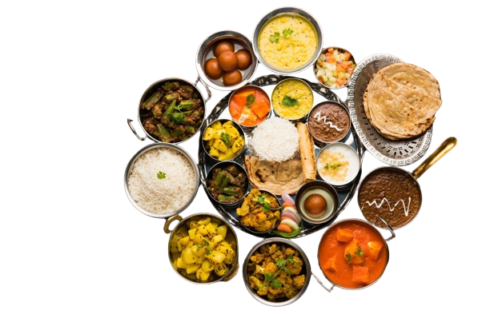
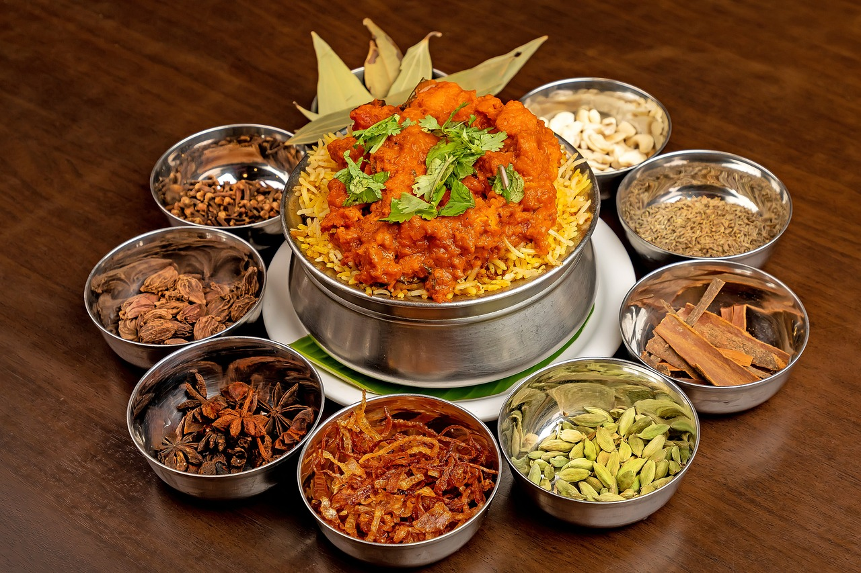
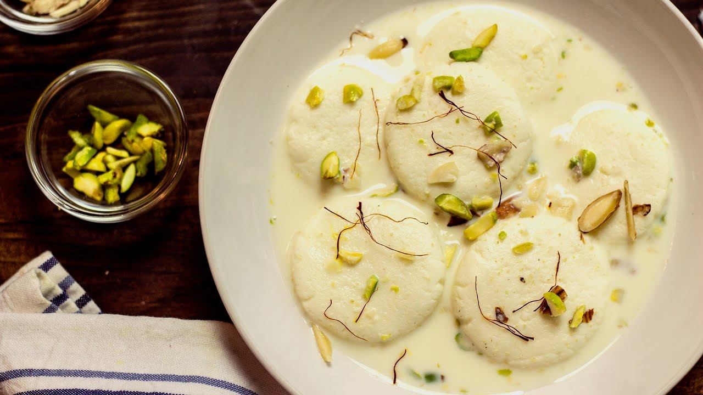
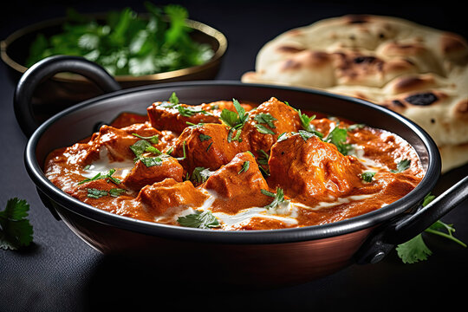
G
enerate Recipe
from Food Image
Introduction to Software Engineering
Presented to: LIJUAN ZHOU Laoshi
Biriyani
Rosomalai
Butter Chicken

Slide 2




OUR TEAM
MOHAMMAD HAMIM
202280090114 – Software Engineering
NISHAT BIN MD HARUN
202280090123 – Software Engineering
RAZIUL HASAN NAYON (TEAM LEADER)
202280090122 – Software Engineering

Slide 3

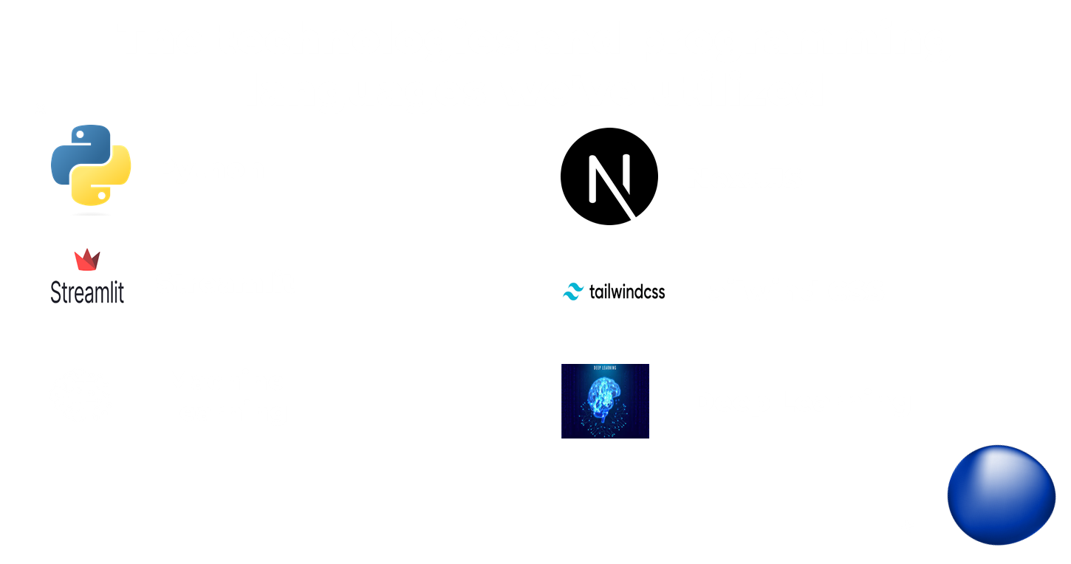

Slide 4
OUR DATASET
SOUTH ASIA
We possess an extensive dataset comprising over 80 food recipes from across South Asia.

Slide 5
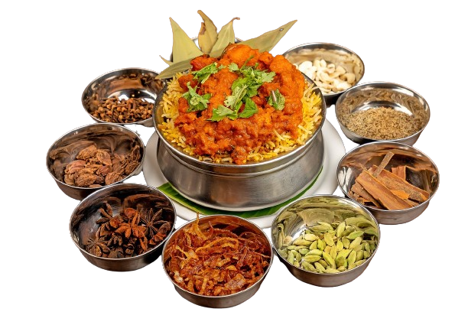
Design & Algorithm

Slide 6

System Architecture
Overview of Architecture:Input: Food Image
Processing: Image Analysis, Food Prediction, Recipe Retrieval from CSV
Output: Food Name and Recipe

Slide 7
Image Analysis Module
Technology Used: Convolutional Neural Networks (CNN)
Process:
Image Preprocessing
Feature Extraction
Food Classification
Tools: TensorFlow, Keras

Slide 8
Food Prediction
Model Details:
Train Dataset
Fine-tuning for specific food categories
Accuracy and Performance:
Training Dataset (99.3%)
Validation(84.3%) and Testing Results(88.4%)

Slide 9
Recipe Retrieval Module
Recipe Database:
Format: CSV file containing food names and corresponding recipes
Structure: Columns for food name and recipe details
Search Mechanism:
Process:
CNN model predicts the food name.
Search for the predicted food name in the CSV file.
Retrieve and display the recipe.
Algorithm: Efficient lookup using pandas library
Example:
Predicted Food: "Pasta"
CSV Lookup: Retrieve recipe for "Pasta" from the file

Slide 10

Integration and Workflow
Workflow Steps:
Upload Image
Image Processing and Prediction
Search for Predicted Food in CSV
Display Recipe

Slide 11
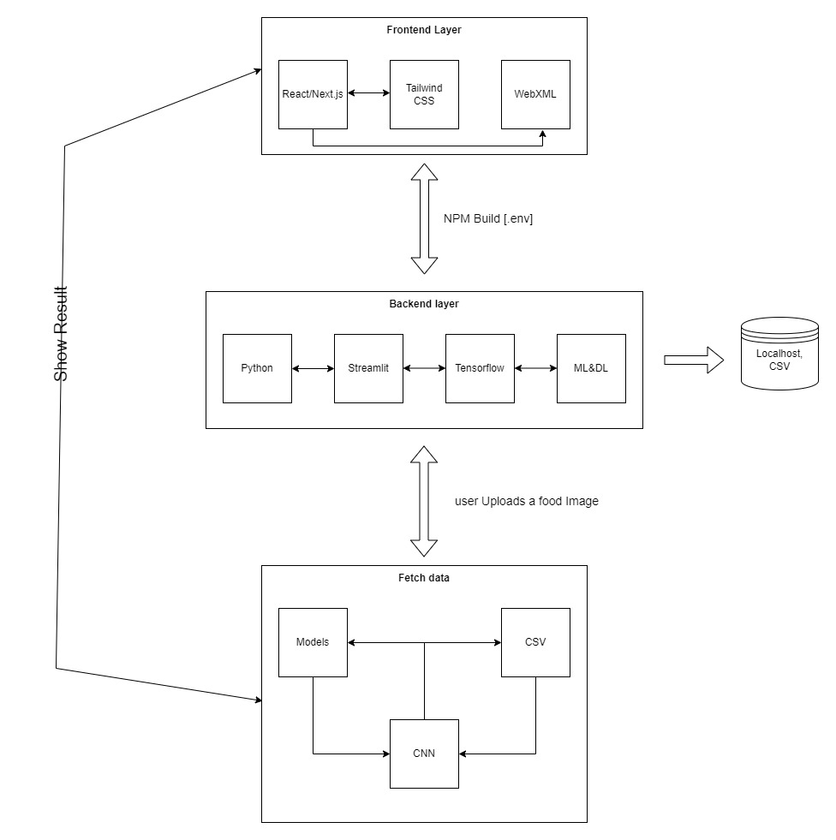
Diagram

Slide 12
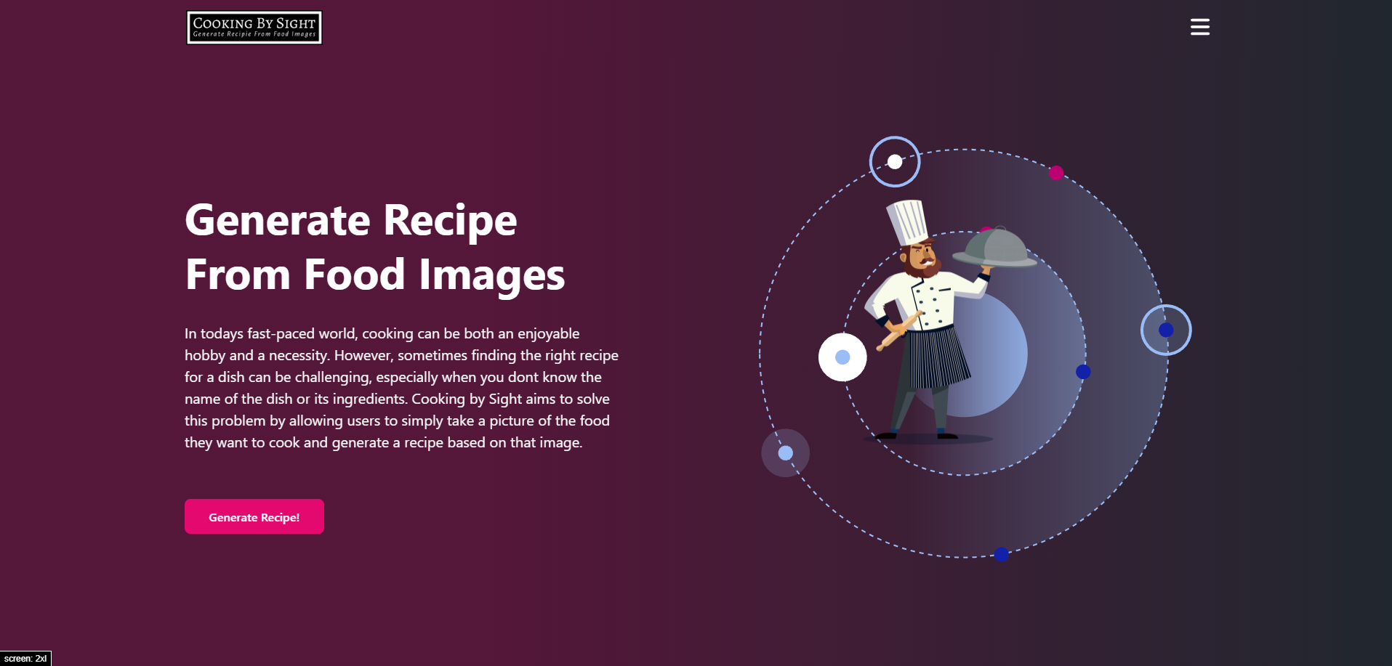
User Interface
UI Design
Web Interface for Image Upload
Result Display: Food Name and Recipe
Tools Used: HTML, CSS, JavaScript, Flask/Django for backend

Slide 13

Our Project Video

Slide 14
SPECIAL FOOD
Thank you

